Slide 1
Fairness in AI with Fairlearn

Slide 2


About me
Bert Wassink, Data scientist @

Slide 3

Agenda
Fairness
(Un)fairness examples
Fairness metrics in a classification setting
Demo
https://fairlearn.github.io/

Slide 4
Fairness
Fairness is the process of understanding bias introduced by your data, and ensuring your model provides equitable predictions across all demographic groups [1].
Whether an AI system is behaving unfairly in terms of its impact on people; harms [2].
Notes:
[1] https://cloud.google.com/blog/products/ai-machine-learning/building-ml-models-for-everyone-understanding-fairness-in-machine-learning
[2] https://fairlearn.github.io/user_guide/fairness_in_machine_learning.html#fairness-of-ai-systems

Slide 5
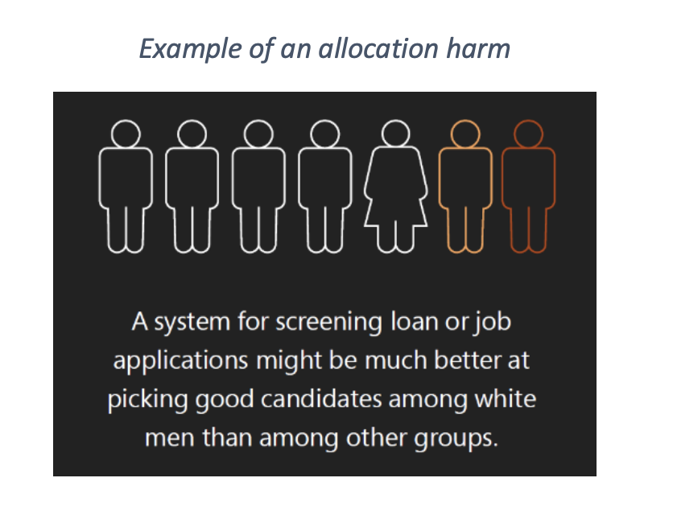
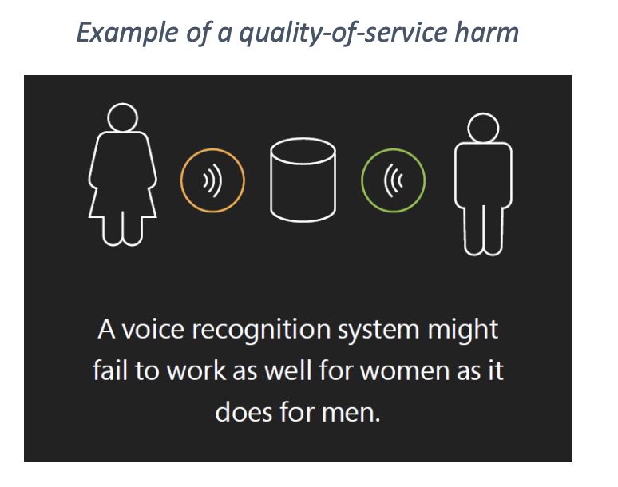
Harms
Notes:
Allocation harm:
Amazons hiring algorithm that did not want to hire women
https://www.reuters.com/article/us-amazon-com-jobs-automation-insight/
VCs that prefer to fund white males
Quality of service harm:
- Black women that cannot be recognized by facial recognition

Slide 6
Toolbox
A set of metrics and a dashboard to get insight about the undesired effects
Integrated with AzureML
Mitigating methods to decrease differences among groups
Preprocessing (not yet)
Reductions (during training)
Postprocessing (after training)

Slide 7
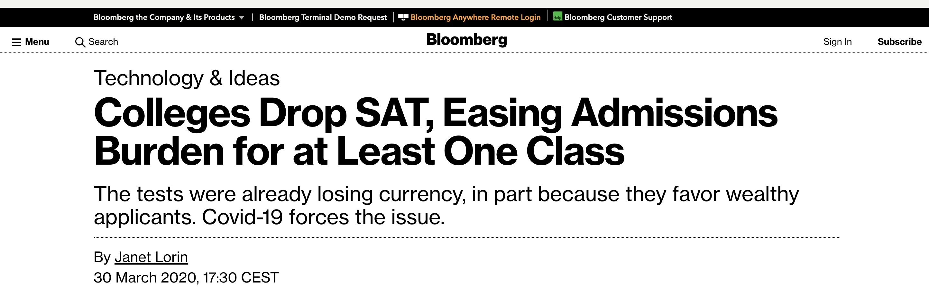
Unawareness (1/ 3)
Universities implicitely discriminate based on income via the confounding SAT tests.
Students from wealthy families have more money to pay for tutoring and retaking the same tests.
Notes:
Universiteiten "discrimineerden" op basis van inkomen via de SAT toelatingstoetsen.
"Standardized test scores favor wealthy students who have tutors and can retake tests, which means that eliminating the scores helps level the playing field."
https://www.bloomberg.com/news/articles/2020-03-30/colleges-drop-sat-and-act-easing-burden-of-testing-for-admission
Dijkhoff stelde voor om criminaliteit in probleemwijken harder aan te pakken, terwijl zo indirect ook een migratengroep harder wordt aangepakt.
Hij wil dat het kabinet wijken selecteert waarin meer dan 50 procent van de inwoners van niet-westerse afkomst is, de werkloosheid is en criminaliteit hoog liggen en het opleidingsniveau laag is.
https://www.ad.nl/politiek/vvd-criminaliteit-in-probleemwijken-dubbel-zo-hard-bestraffen~a8839594/?referrer=https://www.google.com/

Slide 8

Unawareness (2/ 3)
In problem areas tend to live more migrants.
If you would enforce this idea, you are likely to punish people from another origin harsher.
Notes:
Dijkhoff stelde voor om criminaliteit in probleemwijken harder aan te pakken, terwijl zo indirect ook een migratengroep harder wordt aangepakt.
Hij wil dat het kabinet wijken selecteert waarin meer dan 50 procent van de inwoners van niet-westerse afkomst is, de werkloosheid is en criminaliteit hoog liggen en het opleidingsniveau laag is.
https://www.ad.nl/politiek/vvd-criminaliteit-in-probleemwijken-dubbel-zo-hard-bestraffen~a8839594/?referrer=https://www.google.com/
https://nltimes.nl/2018/09/19/ruling-party-wants-double-punishments-crime-problem-areas

Slide 9
Unawareness (3/3)
A situation in which sensitive attributes are present, but not included in the training data. Because sensitive attributes are often correlated with other attributes of one’s data, a model trained with unawareness about a sensitive attribute could still have disparate impact with respect to that attribute, or violate other fairness constraints [3].
Notes:
[3] https://developers.google.com/machine-learning/glossary/fairness
Higher income is correlated with higher SAT scores -> higher prob to enter
More migrants live in problem areas --> on average they will be harsher punished for the same crimes

Slide 10
Should you explicitly include sensitive attributes in a model?

Slide 11
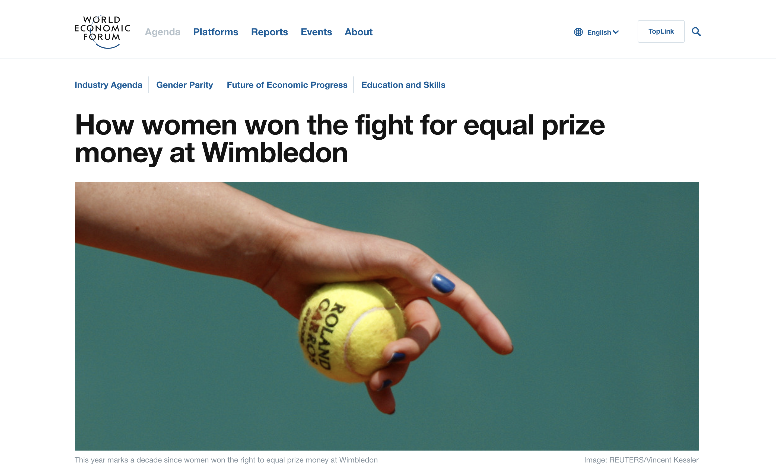
Demographic parity (1/ 4)
Roughly same ratio of women and men are selected for the same price money.
However, exist criticism because of unequal attentance and length of games.
Notes:
Equal prize money, but not always equal attendance, shorter matches
https://www.weforum.org/agenda/2017/07/wimbledon-women-equal-prize-money/

Slide 12
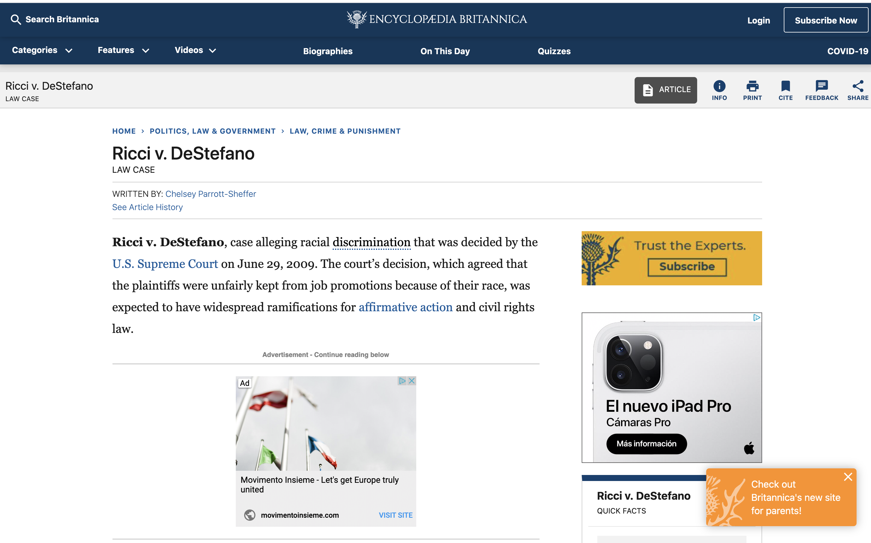
Demographic parity (2/ 4)
Demographic parity cannot always be achieved if it cannot be defended based on the other attributes.
Notes:
After an entry-exam for promotion in the fire department only white people and one Latino were eligible for promotion based on their scores.
At first the municipality of New Haven decided to deny all firefighters the promotion, because they did not want to be liable for a "disparate impact" law suit.
Ricci one of the firefighters that could be promoted on his score, found this unfair and took the municipality to court.
Ricci is dyslectic and he let someone else speak the exam material on tape for a 1000 dollar fee.
Eventuelly the supreme court judged that the municipality had no right to discriminate against the high scores and had to pay a compensation.
https://www.britannica.com/event/Ricci-v-DeStefano

Slide 13
Demographic parity (3/ 4)
A fairness metric that is satisfied if the results of a model's classification are not dependent on a given sensitive attribute[3].
A classifier ℎ satisfies demographic parity under a distribution over (𝑋,𝐴,𝑌) if its prediction ℎ(𝑋) is statistically independent of the sensitive feature 𝐴. This is equivalent to 𝔼[ℎ(𝑋)|𝐴=𝑎]=𝔼[ℎ(𝑋)] [4].
Probability of being selected is undependent of sensitive attribute regardless of other explanatories.
Both one man and woman will win the price money of the winner at Wimbledon
Eventually the New Haven municipality could not promote firefighters according to their demographic parity preference.
Notes:
One demographic parity definition of Google and the other is what Fairlearn uses.
Basically the expectation of all groups should be the same.
[1] https://developers.google.com/machine-learning/glossary/fairness#demographic_parity
[3] Agarwal, Beygelzimer, Dudik, Langford, Wallach “A Reductions Approach to Fair Classification”, ICML, 2018.

Slide 14
Demographic parity metrics (4/ 4)
Selection rate: The fraction of predicted labels matching the ‘good’ outcome if 1 is the 'good' outcome, E[h(x)| A=a].
Demographic parity difference: The difference between the largest and the smallest group-level selection rate across all values a of the sensitive feature.
Demographic parity ratio: The ratio between the smallest and the largest group-level selection rate, 𝐸[ℎ(𝑋)|𝐴=𝑎], across all values 𝑎 of the sensitive feature.
Notes:
Based on the selection rate, we can determine demographic parity.
Selection rate Is percentage that we select. So the rate of the positives.
Maximum absolute difference between the different selection rates gives the demographic parity difference. Ideally the difference is a bit above, but very close to 0.
The parity ratio is basd on the same two groups as the parity difference, only in a ratio setting where the ideal value is close to 1.
The least benefical group is in the nominator, and the preferred group in the denominator.
Criticism on the demographic parity is amongst others that it
- is a strong restriction and your first objective can be hurt a lot
- it may be seen as unfair that it is more difficult for people from some groups to qualify than for people in other groups
(Dutch speed skaters that are better that cannot qualify for the olympics, while they may have more chance to win than others)
https://fairlearn.github.io/user_guide/fairness_in_machine_learning.html#id9

Slide 15
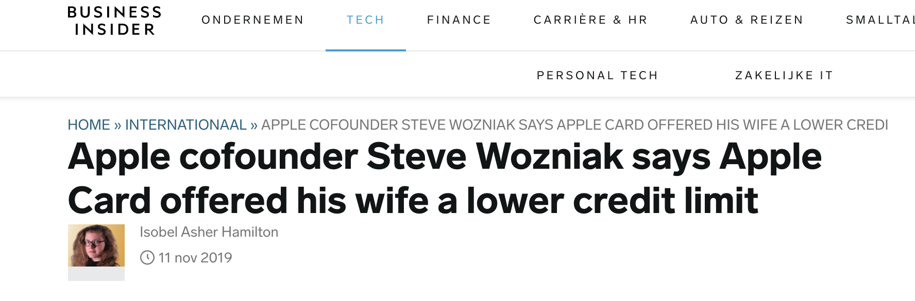
Equalized odds (1/ 4)
Wozniak encountered it unfair since his wife should have the same attributes, given that they own the same assets and thus the same credit possibilities.
Notes:
Wozniak indicated he lives with his spouse and they share all their properties. So she should have all the same attributes as he has except for her gender.
https://www.businessinsider.nl/apple-card-sexism-steve-wozniak-2019-11?international=true&r=US
He was the salutatorian of his class at James Logan High School, with an outstanding GPA, a perfect score on the ACT, and an SAT score of 2230. But he wasn’t just some stereotypical Chinese test-taking robot. He played the piano and founded his high school’s math club. He was a member of his school’s debate team and sang at Barack Obama’s first inauguration ceremony as part of the San Francisco Boys Chorus.
Harvard’s current first-year undergraduate class is about 20% Asian American; if it were to strictly reflect the Asian American population in the US as a whole, that percentage would plummet to less than 6%.
He often points to a much-cited 2009 study by two Princeton sociologists that purports to show that Asian American students must score 140 points higher on the SAT than white students, and 270 points and 450 points higher than Latino and black students, respectively, to have the same chance of gaining entrance to selective universities.
https://www.buzzfeednews.com/article/estherwang/chinese-americans-harvard-affirmative-action-asian-americans

Slide 16
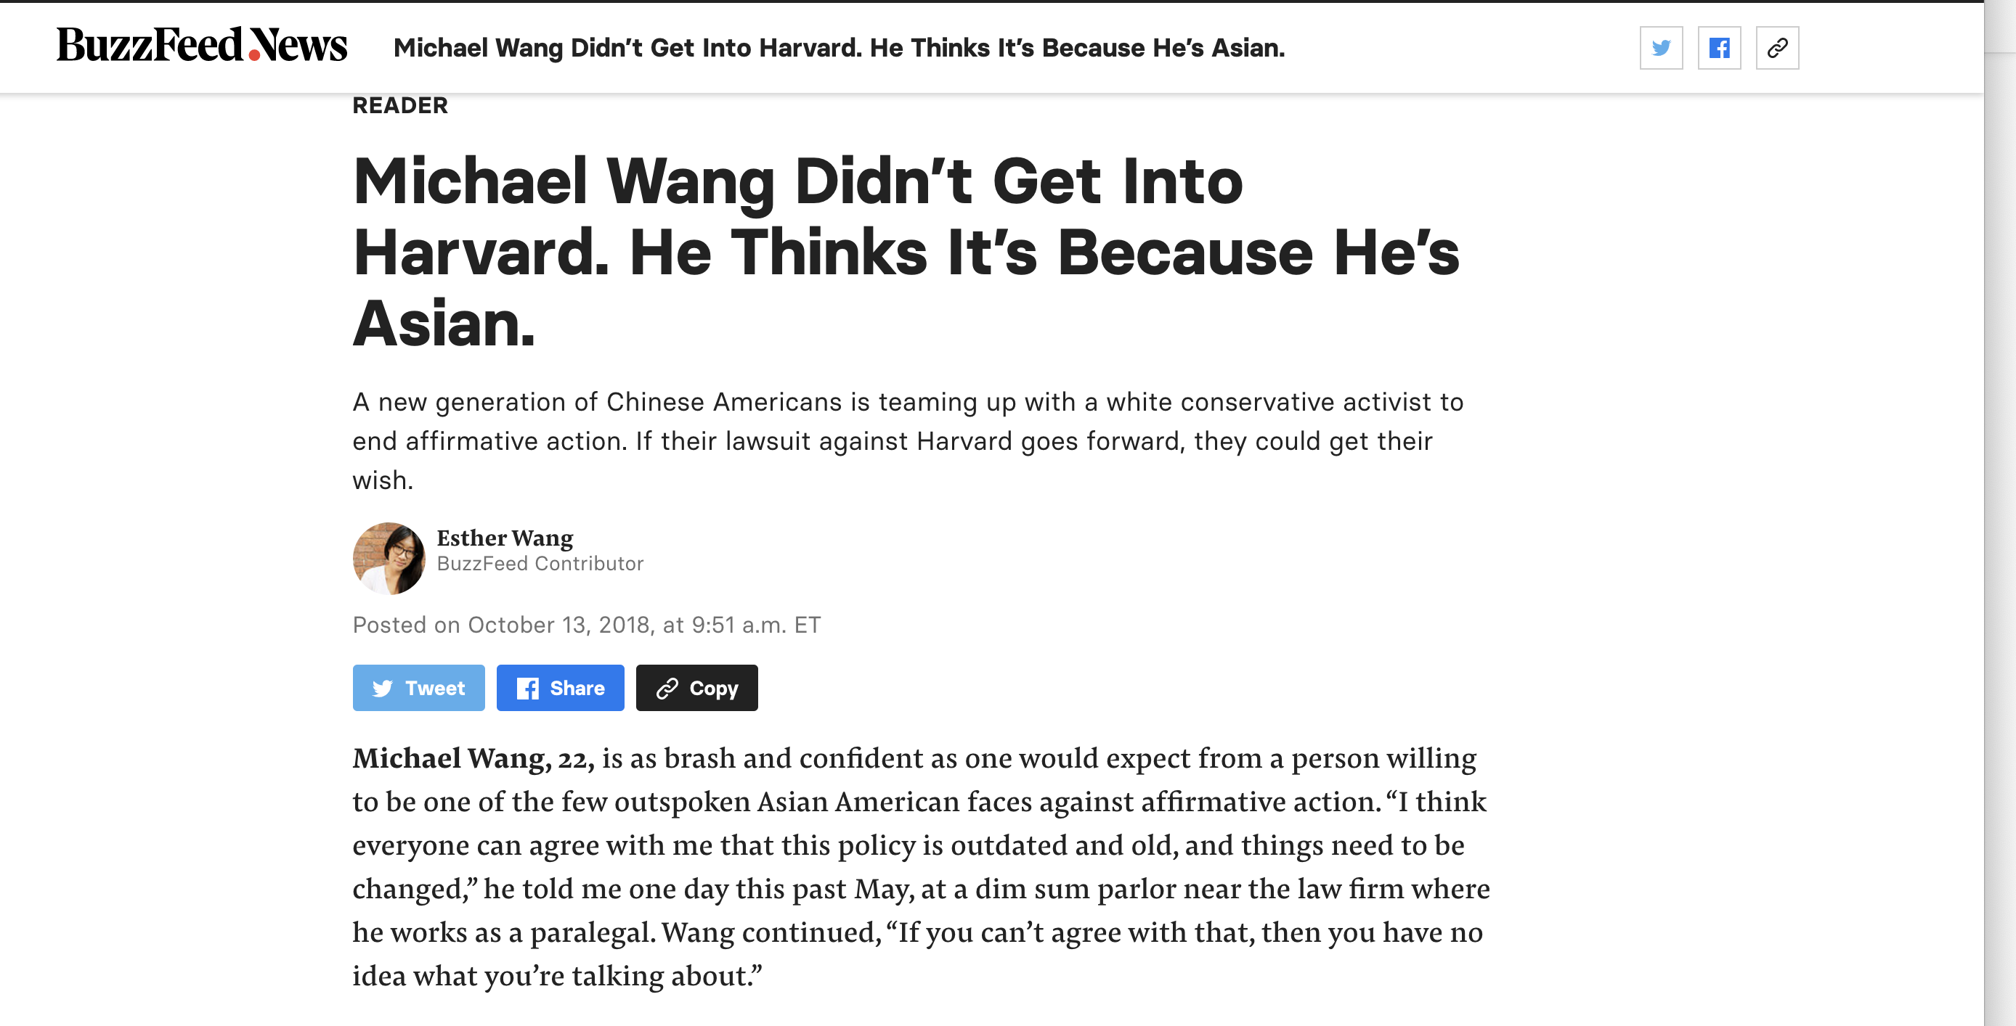
Equalized odds (2/ 4)
He had a perfect ACT score, and a SAT score of 2230 and was active in extracurricular activitities (played piano and founded his high school math club, was a member of the debate club and sang for Obama).
Harvard (20% Asian, while in US population about 6% of asian descent).
He referred to a Princeton study of 2009 that indicates that SAT score of Asians > White > Latino > Black for same probability of entry in selective university.
Notes:
He was the salutatorian of his class at James Logan High School, with an outstanding GPA, a perfect score on the ACT, and an SAT score of 2230. But he wasn’t just some stereotypical Chinese test-taking robot. He played the piano and founded his high school’s math club. He was a member of his school’s debate team and sang at Barack Obama’s first inauguration ceremony as part of the San Francisco Boys Chorus.
Harvard’s current first-year undergraduate class is about 20% Asian American; if it were to strictly reflect the Asian American population in the US as a whole, that percentage would plummet to less than 6%.
He often points to a much-cited 2009 study by two Princeton sociologists that purports to show that Asian American students must score 140 points higher on the SAT than white students, and 270 points and 450 points higher than Latino and black students, respectively, to have the same chance of gaining entrance to selective universities.
https://www.buzzfeednews.com/article/estherwang/chinese-americans-harvard-affirmative-action-asian-americans

Slide 17
Equalized odds (3/ 4)
A fairness metric that checks if, for any particular label and attribute, a classifier predicts that label equally well for all values of that attribute. [3].
A classifier ℎ satisfies equalized odds under a distribution over (𝑋,𝐴,𝑌) if its prediction ℎ(𝑋) is conditionally independent of the sensitive feature 𝐴 given the label 𝑌. This is equivalent to 𝔼[ℎ(𝑋)|𝐴=𝑎, 𝑌=𝑦] = 𝔼[ℎ(𝑋)|𝑌=𝑦] ∀ 𝑎,𝑦 [4].
Notes:
Again two equalized odds definitions. First one is from Googles fairness' glossary and the other is the one that Fairlean is using.
In case of classification y can take the values 0 or 1.
[1] https://developers.google.com/machine-learning/glossary/fairness#demographic_parity
[3] Agarwal, Beygelzimer, Dudik, Langford, Wallach “A Reductions Approach to Fair Classification”, ICML, 2018.

Slide 18
Equalized odds (4/ 4) metrics
False positive rate ratio: False positive: predictive positive and being negative The ratio between the smallest and largest of 𝑃[ℎ(𝑋)=1|𝐴=𝑎, 𝑌=0], across all values 𝑎 of the sensitive feature.
True positive rate ratio (true positive = sensitivity, recall, or hit rate): True positive: predicted positive and being true The ratio between the smallest and largest of 𝑃[ℎ(𝑋)=1|𝐴=𝑎, 𝑌=1], across all values 𝑎 of the sensitive feature.
Equalized odds difference: The greater of two metrics: true positive rate difference and false positive rate difference.
Equalized odds ratio: The smaller of two metrics: true_positive_rate_ratio and false_positive_rate_ratio.
Notes:
Equalized odds is based on the true positives and the false positives.
Thus true positives are the ones that are true and you classify them positive.
False positives are the ones that you uncorrectly classify positive.
For both measures you can create a ratio or a difference between the groups.
The highest difference --> equalized odds difference
The lowest ratio --> equalized odds ratio
Still need to make pull request to change documentation for equalized odds ratio:
Implementation is correct, but documentation mistakenly denotes that it is the smaller of true positive rate and false positive rate ratio
https://fairlearn.github.io/user_guide/fairness_in_machine_learning.html#id9
Has less impact on overall precision
Could be seen as less unfair depending on preference
Equalized probability is if you look only at the true positives

Slide 19
Which definition of fairness do you prefer?

Slide 20
Demo

Slide 21
What determines the amount of accuracy you are willing to sacrifice for fairness?

Slide 22
My opinion
Being unaware is not enough
Data Scientist should show the disparate impact on groups
Mitigate the undesired effects
Realise that it comes with a decrease in accuracy (No free lunch)

Slide 23
For the interested reader
Big Data: A Report on Algorithmic Systems, Opportunity, and Civil Rights The White House. 2016.
Fairness and machine learning, Limitations and Opportunities
Solon Barocas, Moritz Hardt, Arvind Narayanan (In progress)
Weapons of Math Destruction
Cathy o'neill (2017)

